Slide 1
Fundamentals of Deep Learning
Part 2: How a Neural Network Trains

Slide 2
Agenda
Part 1: An Introduction to Deep Learning
Part 2: How a Neural Network Trains
Part 3: Convolutional Neural Networks
Part 4: Data Augmentation and Deployment
Part 5: Pre-trained Models
Part 6: Advanced Architectures

Slide 3
Agenda – Part 2
Recap
A Simpler Model
From Neuron to Network
Activation Functions
Overfitting
From Neuron to Classification

Slide 4
Recap of the exercise
What just happened?
Edited our data (reshaped, normalized, to categorical)
Created our model
Compiled our model
Trained the model on our data
Loaded and visualized our data
Notes:
Okay, so what just happened? Let’s go over it step by step
We loaded and visualized our data
We edited our data to get it into the right shape, as well as normalizing the values between 0-1
We also edited our “answers” to be in a categorical form, instead of a number, as our model will better train with that type of answer
We then created our model, compiled our model, and trained our model on the data

Slide 5
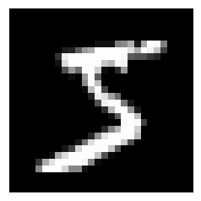
Data preparation
Input as an array
28
[0,0,0,24,75,184,185,78,32,55,0,0,0…]
28
Notes:
Let’s start with our data. We received each 28x28 pixel image as an array of 784 integers.
We then normalized that data (make it between 0-1) by dividing it by 255 (the max value for a pixel)

Slide 6
Data preparation
Targets as categories
0
[1,0,0,0,0,0,0,0,0,0]
1
[0,1,0,0,0,0,0,0,0,0]
2
[0,0,1,0,0,0,0,0,0,0]
3
[0,0,0,1,0,0,0,0,0,0]
.
.
.
Notes:
We then took our ”answers” (or targets), which were in the format of an integer between 0-9 and made it categorical, representing it as an array of 0s with 1 at the index of the correct digit.

Slide 7
An untrained model
[ 0, 0, …, 0]
(784,)
… … …
(512,)
Layer
Size
… … …
(512,)
(10,)
Notes:
Let’s next talk about our model (show picture of model)
We can’t fully represent it in a slide, because it has many connections
Remember that there are 784 inputs, two layers of 512 neurons (or nodes), and an output layer of 10 neurons (one for each digit)
Every neuron in each layer is connected to every neuron in the next layer. This is what the “Dense” Keras layer means.
This means there are a lot of connections (784x512 + 512x512 + 512x10)
Looking at this, can anyone guess the approximate magnitude?
668,672 connections
(Each neuron also has a bias term, but we’ll get to that in a bit)
That’s a whole lot for a network for 4 layers
That can store a whole lot of information. Think about a megabyte of info (1 million bytes) and the fact that a megabyte is about 500 pages of text.
So if each neuron has a connection between the other, how do we store information?
We store it in the “weights” between two neurons
This is the analogous to the strength of connection between the neurons of our brain (although with some differences in the mechanisms)
So how do we update those weights?

Slide 8
A Simpler Model
Notes:
In order to understand how this network came about, let’s looks at the simplest possible model.

Slide 9



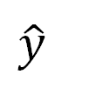
A Simpler Model
$$y=mx+b$$
m•x
$$m= ?$$
x | y
1 | 3
2 | 5
$$b= ?$$
$$\hat{y}$$
Notes:
Each of the circles on the slide before is a neuron. The earliest use case of this neuron was to build a regression line, good ol’ y = mx + b. Regression is when we use a continues input to predict a continuous output, like using how many seconds a pot of water has been sitting on the stove to predict the temperature of the water.
For each variable coming into our neuron, we’re going to find a slope (m), or “weight” for it. The “b”, or y-intercept, from y = mx + b is stored with the neuron.

Slide 10
A Simpler Model
$$y=mx+b$$
m•x
$$m= ?$$
x | y
1 | 3
2 | 5
$$b= ?$$
$$\hat{y}$$
Notes:
Our goal here is to find a line that can go through these points. That way, we can use that line to make predictions.

Slide 11
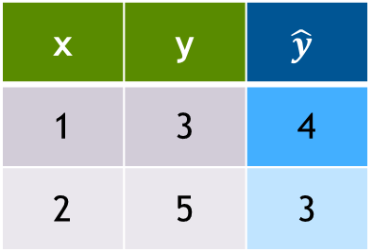


A Simpler Model
$$y=mx+b$$
Start Random
m•x
x | y | $$\hat{y}$$
1 | 3 | 4
2 | 5 | 3
$$m=−1$$
$$b=5$$
$$\hat{y}$$
Notes:
Some of you that have taken statistics before probably know of a more deterministic way to get m and b. (We can verify through algebra m = 2 and b = 1). We’re going to do a more trial and error approach. We’re going to pick a random value to start (usually between -1 and 1, but we’re going to pick -1 for m and 5 for b to make things easier to visualize)
The y hat here (the one with the little hat), is going to be our estimate of the true value, y. Most of the time, our guess is going to be a bit off, so how do we correct it?

Slide 12
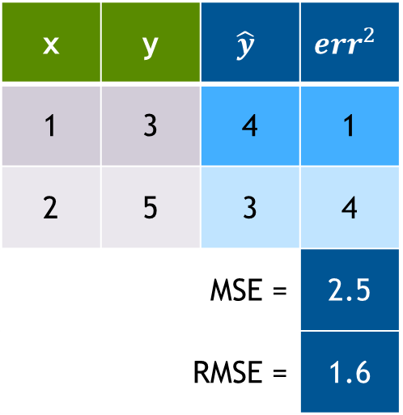

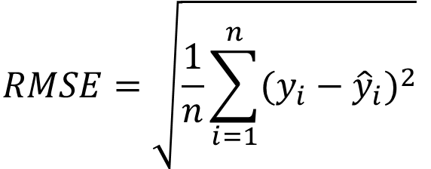
A Simpler Model
$$y=mx+b$$
x | y | $$\hat{y}$$ | $${err}^{2}$$
1 | 3 | 4 | 1
2 | 5 | 3 | 4
MSE = |  |  | 2.5
RMSE = |  |  | 1.6
$MSE= \frac{1}{n}$ $\sum_{i=1}^{n}{{(y_{i}−{\hat{y}}_{i})}^{2}}$
$$RMSE=\sqrt{\frac{1}{n}\sum_{i=1}^{n}{{(y_{i}−{\hat{y}}_{i})}^{2}}}$$
Notes:
Traditional regression lines are built on the concept of least squared error, meaning, we’re going to take the difference of each estimate from the true value and square it. This keeps our error positive so when we figure out our total error, they don’t cancel each other out. It also strongly punishes bad guesses.

Slide 13
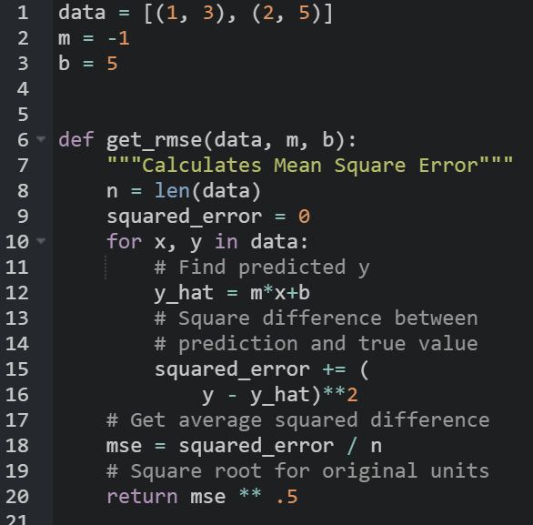
A Simpler Model
$$y=mx+b$$
x | y | $$\hat{y}$$ | $${err}^{2}$$
1 | 3 | 4 | 1
2 | 5 | 3 | 4
MSE = |  |  | 2.5
RMSE = |  |  | 1.6
Notes:
So if it’s been a while since seeing some of these math symbols, no problem, we can code our RMSE like this. For each of our points, we’ll figure out what the difference is between y and mx+b. Then we’ll square that difference, and then take the average of all squared differences.
https://black.now.sh/
Code:
data = [(1, 3), (2, 5)]
m = -1
b = 5
def get_rmse(data, m, b):
"""Calculates Mean Square Error"""
n = len(data)
squared_error = 0
for x, y in data:
# Find predicted y
y_hat = m*x+b
# Square difference between
# prediction and true value
squared_error += (
y - y_hat)**2
# Get average squared difference
mse = squared_error / n
# Square root for original units
return mse ** .5

Slide 14
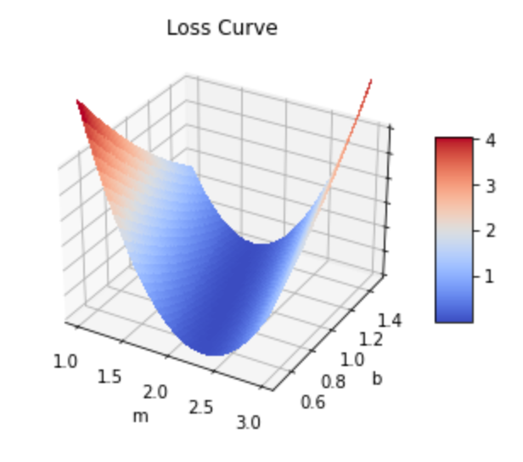
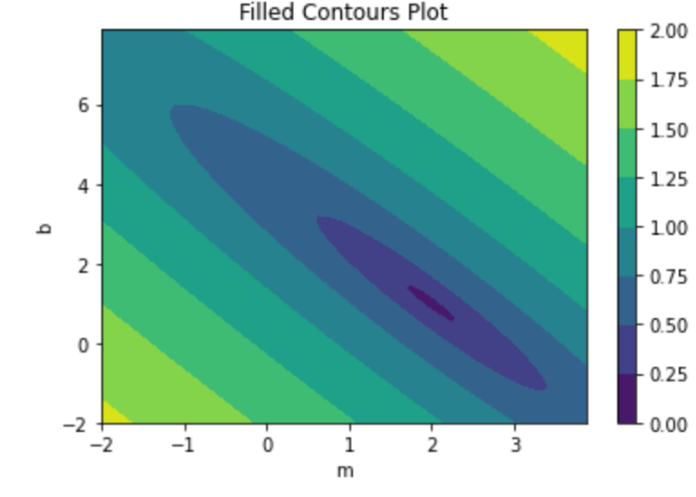
The Loss Curve
Loss Surface
16
0
MSE
MSE
Notes:
Ok, phew, that was a lot of math. Let’s graph out our m and our b in relation to our mean squared error. On the left, we have a surface plot of our loss function. That’s the error function we choose to evaluate our model, which in our case is MSE. It’s a little hard to read, so on the right, we’ve plotted the contours. With that, we can see that it’s actually a kind of parabolic ellipse that bottoms out at b=1 and m=2.

Slide 15


The Loss Curve
16
0
Current
MSE
Target
$$m=−1$$
$$b=5$$
Notes:
So if this is our guessed line, we can see where our current position is on the curve. Our goal is to find the minimum error, and since it’s a toy example, we know that the minimum is 0. For us humans, it’s easy to see that the bottom is around m = 2 and b = 1, but for the computer, it’s not so easy to see that. (The computer can’t visualize this loss curve without some help, we gave it a grid of x,y points, and told it to graph that area). Turns out, the computer isn’t the best at calculus, so we’re going to help it cheat.
We have two leavers to help us move: m and b. We can change b, our intercept, or m, our slope. Let’s start with b, our intercept. If we subtract one…

Slide 16

The Loss Curve
16
0
Old
Current
MSE
Target
$$m=−1$$
$$b=4$$
Notes:
Cool, our line hits one of the points now, but it’s missing the other one. Let’s increase the slope by one…

Slide 17

The Loss Curve
16
0
Current
MSE
Target
$$m=0$$
$$b=4$$
Notes:
Darn it, now we’re missing both points, but the MSE did decrease from 2.5 to one.

Slide 18
The Loss Curve
The Gradient
Which direction loss decreases the most
$λ$: The learning rate
λ: The learning rate
How far to travel
Epoch
A model update with the full dataset
Batch
A sample of the full dataset
Step
An update to the weight parameters
16
0
16
0
MSE
Target
Notes:
The computer doesn’t have our “human eyeball” ability to guesstimate what it should change in order to get to the bottom of this bowl, so what it’s going to do is given the current point that it’s at, it’s going to calculate the gradient, which is a fancy word to describe a multivariate slope. It’s going to figure out in which direction is the loss decreasing the most, which is going to be some ratio of b to m.
Once we have a direction, we need to figure out how far to travel with it. The gradient is going to change depending on our current position, so we don’t want to make to big of a step because we can accidentally move further away from our target. We also don’t want to be too small because that means it can take a long time to get to our goal, and life it too short to wait for a model to finish training. The amount we travel is something we decide, and it is a parameter called learning rate.
Now that we’re in a new position, we repeat the process: find the new gradient and take another step. There’s a few ways to measure our progress. There are Epochs, which is another way to say to full dataset. It used to be that people calculated the gradient using the full dataset, but nowadays, people see that it’s more efficient to use a sample or batch from the dataset. In either case, a step is when we take either the full dataset or a batch, calculate the gradient, and update our parameters with the gradient and learning rate.

Slide 19
The Loss Curve
The Gradient
Which direction loss decreases the most
$λ$: The learning rate
λ: The learning rate
How far to travel
Epoch
A model update with the full dataset
Batch
A sample of the full dataset
Step
An update to the weight parameters
16
0
MSE
Target
Notes:
After a few steps, this is what our journey will look like. This process to find the minimum loss is called gradient descent.

Slide 20

Optimizers
Loss – Momentum Optimizer
Adam
Adagrad
RMSprop
SGD
Notes:
Thankfully, a lot of research has been done on the best way to define the learning rate, and machine learning frameworks have a few tools that will automatically adjust the learning rate.
For instance, a popular one is Adam (Adaptive momentum) which is kind of like thinking of our loss curve as a mountain and our position as a marble. If we drop a marble on top of a mountain, it will pick up speed, jumping over trenches (local minima) before hopefully landing at a lower minima.
Adam has since been improved, and the current default in TensorFlow is called ‘RMSprop’.

Slide 21
FROM NEURON TO NETWORK

Slide 22
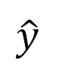
Building a Network
Scales to more inputs
w₁
w₂
$$\hat{y}$$
Notes:
Now that we have the core concept down, we can start building up our network. Instead of having a singular x input with a slope (m), we’re going to have multiple x inputs (x1, x2, x3…) and find each of them a weight. Our previous math stays mostly the same, we just need to find the gradient for the new variable like we did before.

Slide 23
Building a Network
x₁
x₂
w₂
w₃
Scales to more inputs
Can chain neurons
w₁
w₄
w₅
w₆
$$\hat{y}$$
Notes:
We can also take the output of one neuron and feed it into another, and as long as we don’t make a loop, we can connect the same output to multiple inputs. Badum! With this we officially have a deep learning network. When we calculate our new weights from gradient descent, we can use the error calculated in a later neuron as part of the error for the previous neuron it’s connected to.
Most frameworks automate this part for us, so we’re not going to go much into the math, but here’s a great self paced animation that dives deeper into how it works: https://developers-dot-devsite-v2-prod.appspot.com/machine-learning/crash-course/backprop-scroll

Slide 24

Building a Network
x₁
x₂
w₂
w₃
Scales to more inputs
Can chain neurons
If all regressions are linear, then output will also be a linear regression
w₁
w₄
w₅
w₆
$$\hat{y}$$
Notes:
There is one mathematical “gotcha” we should keep an eye out for and that’s our “activation function”. Right now, we’re just doing a linear sum, so we get a line in 2D and a plane in 3D. This is a bit of a waste on a neural network since the only output we’ll get from adding lines together is another line, and it would be nice to be able to capture complex shapes.

Slide 25
Activation Functions

Slide 26
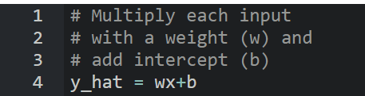

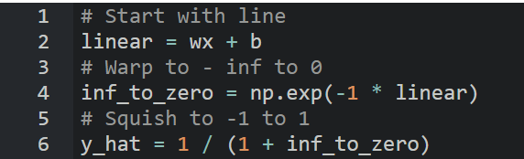
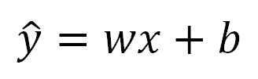

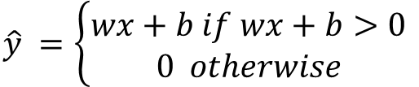
Activation Functions
Linear
ReLU
Sigmoid
$$\hat{y}=wx+b$$
$$\hat{y} =\left\{\begin{aligned}wx+b if wx+b>0 \\ 0 otherwise\end{aligned}\right.$$
$$\hat{y} =\frac{1}{1+e^{−(wx+b)}}$$
Notes:
For graphs, w = 1 and b = 0
Here’s the strategy: computers like equations of a line because they’re quick to compute and it’s easy for us to give it the rules on how to differentiate them.
One easy way to add non-linearity is to feed our equation of a line into another non-linear function. One of the most popular ones is ReLU, the Rectified Linear Unit. That’s just a fancy way of saying whenever the output of our line is negative, we’re going to set it to 0. Because the output of our neuron gets assigned a weight if it’s fed into another neuron, there’s a chance the output can become negative.
Another important activation function is Sigmoid. It manipulates our line so we get this S shape that goes from 0 to 1. This is great, because then we can use our neurons to assign probabilities to predictions.
Code:
# Multiply each input
# with a weight (w) and
# add intercept (b)
y_hat = wx+b
# Only return result
# if total is positive
y_hat = wx+b
y_hat = y_hat * (y_hat > 0)
# Start with line
linear = wx + b
# Warp to -inf to 0
inf_to_zero = np.exp(-1 * linear)
# Squish to -1 to 1
y_hat = 1 / (1 + inf_to_zero)

Slide 27
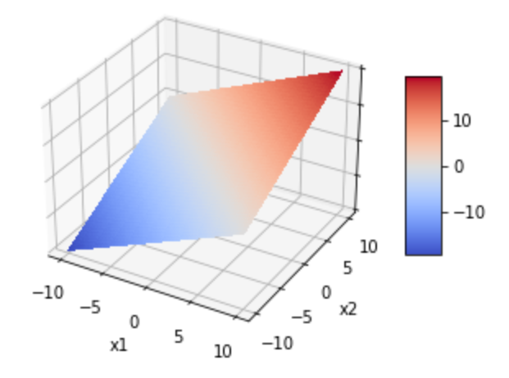
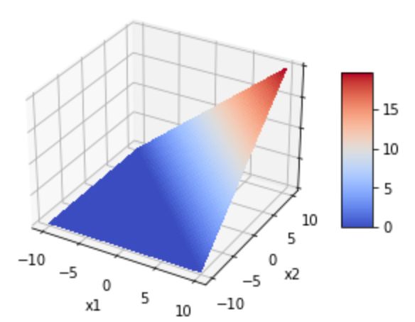
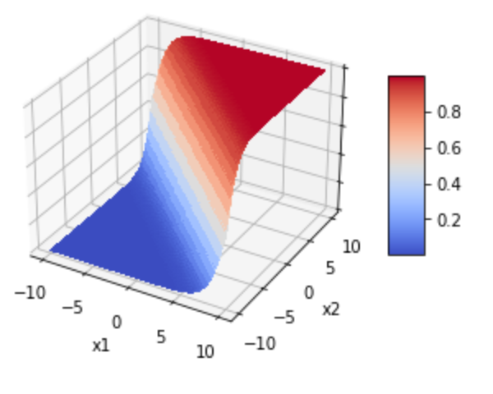
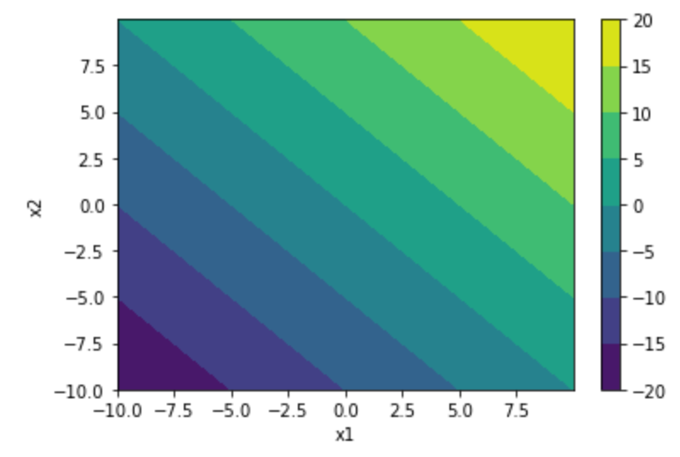
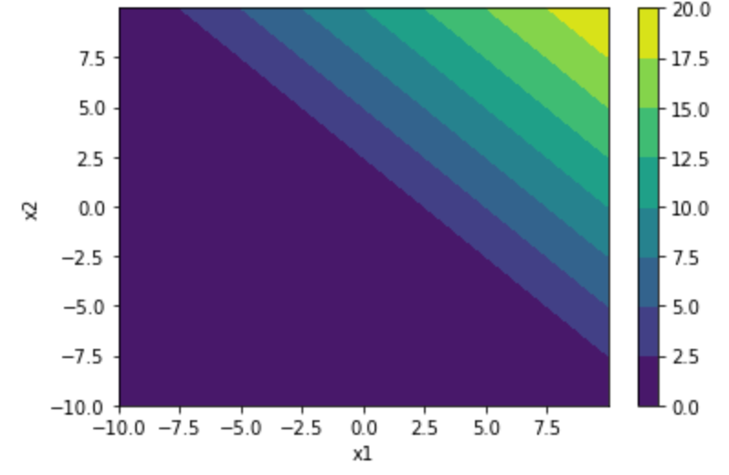
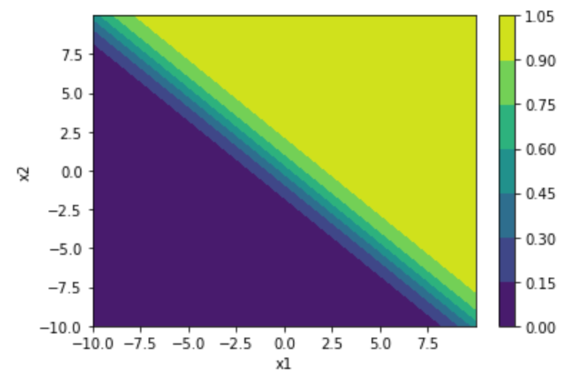
Activation Functions
Linear
ReLU
Sigmoid
Notes:
All of these graphs start with linear($y=\sum_{i=1}^{n}{w_{i}x_{i}}+b$), and then squeezes the plane/line through the activation function.
For graphs w1 = 1, w2 = 1, and b = 0
In actuality, we’re likely to have more than one input into our neuron, and this is what shape these activation functions give our neurons in three-dimensional space. Linear is just a plane, like a sheet of paper. ReLU is like a wedge. Sigmoid is like a surf wave.

Slide 28



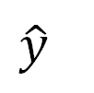


Activation Functions
x₁
w₁
w₂
w₃
w₄
$$\hat{y}$$
Notes:
Here’s how an understanding of all this math is going to help. Let’s say we have a one input one output dataset that we suspect is a summation of two waves. We can use a Sinusoidal activation function in our first layer, and a linear activation in our last layer so we can add the two.
Given enough data, our neural network will figure out the parameters of each of these sub-components for us. Having a general understanding of the shape of the data and the relationship between the variables can help us build more efficient models for our data, saving time, computation, and ultimately, money.

Slide 29
OverFitting
Notes:
So if we can make these complicated shapes with more layers and neurons, why not make a super big neural network to solve every problem?

Slide 30

Overfitting
Why not have a super large neural network?
Notes:
Can anyone think of what the pitfalls would be from having too big of a model.
We could be wasting a lot of computational resources, and it can also take longer to train, but there’s another problem we should be aware of too.

Slide 31
Overfitting
Which Trendline is Better?
MSE = .0000
MSE = .0113
Notes:
The problem goes back to classical statistics, but it still plagues neural networks. Let’s say we’ve gone out, collected some data, and created two models. Which on of these is better?
Going by the RMSE, it’s the one on the left.
But what if we go out at get a new sample of data?

Slide 32
Overfitting
Which Trendline is Better?
MSE = .0308
MSE = .0062
Notes:
It turns out, our simpler model does a better job generalizing to new data. Not all problems can be so simple, and it’s the job of a Data Scientist to be able to determine the correct complexity for the model given

Slide 33
Training vs validation data
Avoid memorization
Training data
Core dataset for the model to learn on
Validation data
New data for model to see if it truly understands (can generalize)
Overfitting
When model performs well on the training data, but not the validation data (evidence of memorization)
Ideally the accuracy and loss should be similar between both datasets
Notes:
Remember when we had two separate pools of data (training and validation)?
So that we can be sure the network is not just “memorizing” the data that it’s learning on
We need to make sure that when it sees new and different images, that it is accurate as well
If the model performs well on training data, but not on new data, we call this over-fitting

Slide 34
From Regression to Classification
Notes:
We just went over many parts of a neural network. Let’s see how it applies to the last lab.

Slide 35
An MNIST Model
[ 0, 0, …, 0]
(784,)
… … …
(512,)
Layer
Size
… … …
(512,)
(10,)
Notes:
This was the visualization of the model in the previous lab. Can you name some of the components that we just learned on this diagram? Any details missing?

Slide 36
An MNIST Model
[ 0, 0, …, 0]
(784,)
ReLU
… … …
(512,)
Layer
Size
ReLU
… … …
(512,)
Sigmoid
(10,)
Notes:
Here’s a more detailed version of the diagram, now including activation functions. We use ReLu in our hidden layer to add efficient nonlinearity, but why use sigmoid at the end? This way we get a probability for each digit!
Hmm, but wouldn’t it be useful if all of the probabilities for all ten of our digits added up to 100%? How would we do that?

Slide 37
An MNIST Model
[ 0, 0, …, 0]
(784,)
ReLU
… … …
(512,)
Layer
Size
ReLU
… … …
(512,)
Softmax
(10,)
Notes:
No problem, there's a function many ML libraries have called softmax. It’s going to add the results of all the sigmoid functions across the layer and then reweight them so that they add up to 100%.

Slide 38
RMSE FOR PROBABILITIES?
Notes:
Let’s say we have a group of points that are categorized by color. How would we use an RMSE line to predict whether a new data point is going to be red or blue?

Slide 39
RMSE FOR PROBABILITIES?
Notes:
This time, we want to find a line that best separates the data. The error function that we use to calculate our gradient descent is called the loss function or cost function. RMSE and MSE are one kinds of loss. We could try to assign numbers to these colors and use RMSE, but there’s a better way.

Slide 40
Cross Entropy
Notes:
The most popular way to approach this problem is with categorical cross entropy. Before we dive into the math, let’s talk about the logic. We’re going to assign a probability to each point whether it is red or blue. We can almost think of this probability as our confidence it is in a particular class.
Cross entropy was designed like this: If we are 100% confident that a point is blue, and we’re right, perfect, we have 0 loss. However, if we’re wrong, we should be punished for our hubris and receive infinite loss! This works in the reverse case as well. If we assign a point a 0% chance of blue, that is we’re absolutely certain it is red, and it is not blue, we get no loss. However, if it is blue, we’ll have infinite loss.

Slide 41
Cross Entropy
$$Loss=−\left((t\left(x\right)∙log⁡(p\left(x\right))+\left(1−t\left(x\right)\right)∙\log\left(1−p(x)\right)\right)$$
$$t\left(x\right)=target (0 if False, 1 if True)$$
$$p\left(x\right)=probability prediction of point x$$
Notes:
Here’s the full mathematical formula for Binary Cross Entropy, meaning we only have two classes. The logarithms are used to get our near infinite loss. It might seem like a lot, but there’s a little trick. The left half cancels to 0 when the target is false, and the right half cancels to 0 when the target is true.

Slide 42
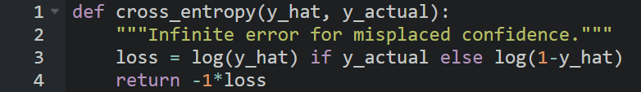
Cross Entropy
Notes:
And here’s the code version, for all you programmers out there. This is the same math as the slide before, but in code form.
y_hat is our prediction that a point is blue, and y_actual is whether a point was actually blue or not. The logarithms are what will push our code to infinity as log(0) is negative infinity
.
Code:
def cross_entropy(y_hat, y_actual):
"""Infinite error for misplaced confidence."""
loss = log(y_hat) if y_actual else log(1-y_hat)
return -1*loss

Slide 43
Bringing it Together
Notes:
Ok, now that we know the major mechanics, let’s talk about the next lab.

Slide 44
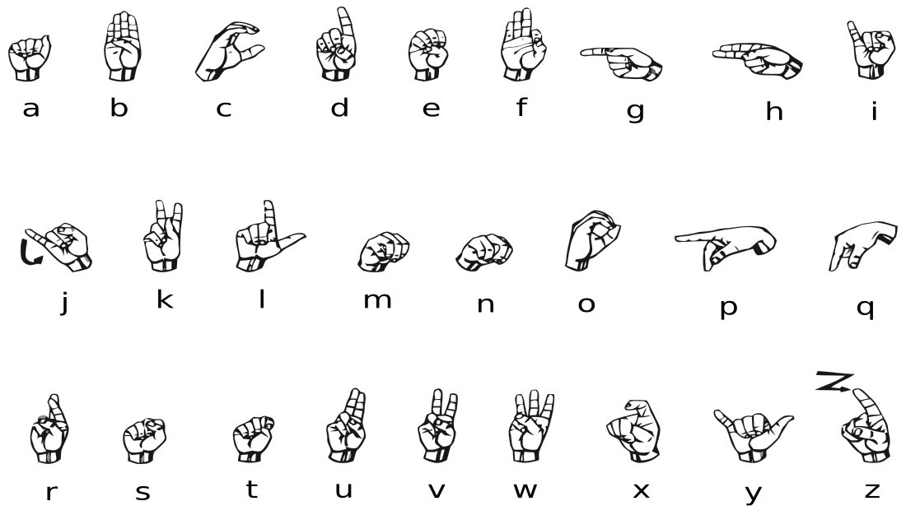
The next exercise
The American Sign Language Alphabet
Notes:
We’re going to try this again with a different dataset:
The American Sign Language Alphabet
Same shape (28x28 pixels) as last time
Same shape (28x28 pixels) in grayscale
Skipping J and Z because they require movement

Slide 45
Let’s go!
Notes:
Let’s get to it!

Slide 46
Appendix: Gradient Descent
Helping the Computer Cheat Calculus
Notes:
Let’s get to it!

Slide 47


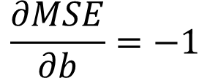
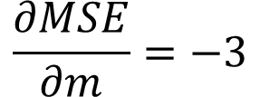
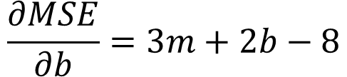
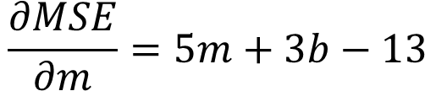
Learning From Error
$MSE= \frac{1}{n}\sum_{i=1}^{n}{{(y−\hat{y})}^{2}}=\frac{1}{n}$ $\sum_{i=1}^{n}{{(y−(mx+b))}^{2}}$
$$MSE= \frac{1}{2}{((3 −(m\left(1\right)+b))}^{2} + {(5 −(m\left(2\right)+b))}^{2})$$
$$\frac{∂MSE}{∂m}=5m+3b−13$$
$$\frac{∂MSE}{∂b}=3m+2b−8$$
$$m=−1$$
$$\frac{∂MSE}{∂m}=−3$$
$$\frac{∂MSE}{∂b}=−1$$
$$b=5$$
Notes:
We know how to calculate MSE given a model. What can we do with that information?
We’re going to take a page from our calculus textbook and minimize the error.
Now, if we want to find the true minimum, we can plug in the values for all of our points and do some multivariate calculus to find m and b, but it turns out that computers are bad at calculus, so we’re going to help the computer cheat a little.
Here, we’ve taken our MSE and expanded it to include our two xy datapoints (1,3) and (2,5)
So it turns out that while computers have a tough time finding the global minimum of a function, they’re pretty decent at calculating the slope of a function given an input. If that function is multidimensional, (as in, more than one input) then that slope is called the gradient.
There are many ways a computer can go about getting the gradient as described in this quora answer: https://www.quora.com/How-does-TensorFlow-calculate-gradients#:~:text=There%20are%20a%20few%20different,another%20to%20approximate%20the%20derivative.
One easy way is to just take two really really close points and calculate the gradient between them. By calculating the gradient, we’re calculating the slope for each parameter we want to learn, and once the slope is 0 for all variables, then we have found a local minimum.

Slide 48
The Loss Curve
Loss Surface
16
0
Current
Target
Notes:
We’re going to use the gradient we calculated earlier to guide our estimate to the goal.

Slide 49
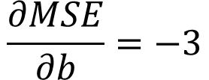
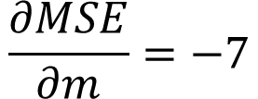
The Loss Curve
16
0
$$\frac{∂MSE}{∂m}=−7$$
$$\frac{∂MSE}{∂b}=−3$$
Target
Notes:
Because both of them are negative, that means we need to increase them in order to get closer to 0. Hmm, the gradient gives us the right direction, but the magnitude is too big.

Slide 50
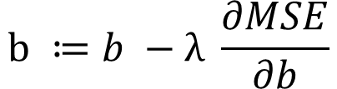
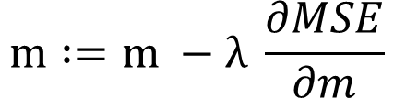
The Loss Curve
16
0
$$\frac{∂MSE}{∂m}=−7$$
$$\frac{∂MSE}{∂b}=−3$$
$$m :=m −λ \frac{∂MSE}{∂m}$$
Target
$$b ≔b −λ \frac{∂MSE}{∂b}$$
Notes:
Let’s introduce a new parameter called the learning rate (represented by lamba λ) which will allow us to scale our changes to our parameters. Data scientists define this on their own, but thankfully, there’s been enough research on the topic that machine learning libraries have their own built in strategies.

Slide 51

The Loss Curve
16
0
$$\frac{∂MSE}{∂m}=−7$$
$$\frac{∂MSE}{∂b}=−3$$
$$m :=m −λ \frac{∂MSE}{∂m}$$
Target
$$λ=.6$$
$$b ≔b −λ \frac{∂MSE}{∂b}$$
Notes:
If we make the learning rate too big, we’re going to get farther away from our goal.

Slide 52

The Loss Curve
16
0
$$\frac{∂MSE}{∂m}=−7$$
$$\frac{∂MSE}{∂b}=−3$$
$$m :=m −λ \frac{∂MSE}{∂m}$$
Target
$$λ=.005$$
$$b ≔b −λ \frac{∂MSE}{∂b}$$
Notes:
If we make it too small, it’s going to take forever to get there. Also, once we train on more complicated problems, we can get trapped in a local minimum.

Slide 53



The Loss Curve
16
0
$$λ=.1$$
$m≔−1+7 λ=−0.3$
$$b ≔5+3 λ=4.7$$
Target
Notes:
For now, let’s stick with a learning rate of .1. Ok, step in the right direction, but not close enough. No problem, we’ll just repeat the process over and over gain, taking our new values of b and m and finding the gradient for them.

